Slide 1

SMART INDIA HACKATHON 2026
TITLE PAGE
Problem Statement ID – SIH6162
Problem Statement Title- AI-Based Detection and Classification of Industrial Fires and Persistent Thermal Sources Using NASA FIRMS, OSM & Satellite Data
Theme- Disaster Management
PS Category- Software
Team ID- 5
Team Name- Antariksh

Slide 2
AGNIRA – AI-Based Industrial Fire Detection
Antariksh
Proposed Solution
Detailed explanation: Agnira pulls NASA FIRMS satellite hotspots (VIIRS/MODIS thermal anomalies) for a region and, for every hotspot, queries OpenStreetMap within a 1 km radius to detect nearby industrial plants, power/oil infrastructure, quarries, natural land or built-up areas. These OSM land-use features are combined with FIRMS thermal signals (brightness, FRP, confidence) and fed into a trained ML classifier that labels each hotspot as Industrial, Natural, or Other, then surfaces it on a live monitoring dashboard with a risk score.
How it addresses the problem: Automatically separates hazardous, persistent industrial fires from routine agricultural or seasonal heat sources -- cutting manual verification effort for disaster-response and pollution-control teams.
Innovation and uniqueness: Fuses satellite thermal data with real-world spatial context (OSM) and an explainable risk score (confidence %, contributing factors, e.g. "industrial facility within 1 km") rather than just plotting raw hotspot dots on a map.

Slide 3
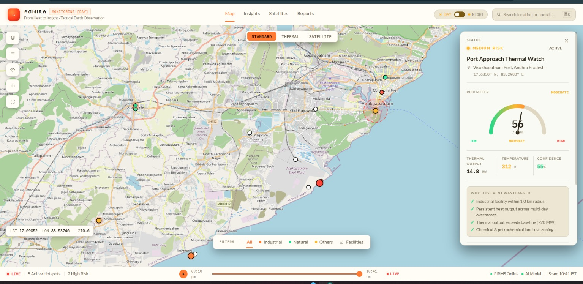
TECHNICAL APPROACH
Antariksh
Data source: NASA FIRMS (VIIRS/MODIS) active-fire hotspot feed, pulled for the last 4 months around the 100 km radius of Delhi.
Spatial context: OSM Overpass API queries a 1 km radius around every hotspot for industrial land-use, power plants, oil/gas facilities, quarries, and natural/built-up land.
ML model: Python (scikit-learn) classifier trained on FIRMS thermal features (brightness, FRP, confidence) + OSM facility-class features to label each hotspot as Industrial, Natural, or Other.
Frontend: Web-based live monitoring dashboard (map view, risk meter, "why flagged" reasoning panel) shown alongside using CSS, HTML, and JavaScript
Agnira live monitoring dashboard (prototype) – hotspot map, risk meter & flagging reasons

Slide 4
FEASIBILITY AND VIABILITY
Antariksh
Feasibility: NASA FIRMS and OpenStreetMap are both free, open, and globally available, so the pipeline needs no paid satellite subscription; the ML model is lightweight enough to run on a standard server and refresh with each new satellite overpass.
Challenges & risks: FIRMS hotspot pixels are coarse (~375 m-1 km), so a fire and a nearby industrial facility can appear at the same point; OSM coverage/tagging quality also varies by region, and satellite revisit gaps limit true real-time detection.
Mitigation strategy: Combine multiple FIRMS passes (persistence over time) to reduce single-pixel error, widen/adjust the OSM buffer per facility type, and continuously retrain the classifier as more confirmed/false-positive labels are collected.

Slide 5
IMPACT AND BENEFITS
Antariksh
Target audience: Disaster management authorities, pollution-control boards, forest/environment departments, and industrial safety regulators who need to triage fire alerts quickly.
Social benefit: Faster, more reliable early warning for communities living near industrial zones prone to persistent fires or thermal leaks.
Economic benefit: Reduces manual field-verification cost by pre-filtering satellite hotspots, letting limited inspection teams focus only on high-risk, industrial-linked events.
Environmental benefit: Enables earlier intervention on industrial fires/emissions, limiting air-quality damage, and helps distinguish genuine hazards from harmless natural or agricultural heat sources.

Slide 6
RESEARCH AND REFERENCES
Antariksh
NASA FIRMS (Fire Information for Resource Management System) – active fire/thermal anomaly data, VIIRS & MODIS: firms.modaps.eosdis.nasa.gov
OpenStreetMap Overpass API – land-use, industrial, power & oil-infrastructure tagging used for the 1 km context buffer: overpass-api.de
NASA FIRMS user guide & VIIRS/MODIS active fire product documentation for confidence, brightness and FRP fields
scikit-learn documentation – classification models used to train the Industrial / Natural / Other hotspot classifier
4 months of historical FIRMS hotspot records (India region) collected and labelled by the team for training and validation

